Slide 1

Hungry Slugs 4/16/2024
Ian (Product Owner)
Akshat (Current Scrum Master)
Anya
Akhil
Noah

Slide 2

Hungry Slugs
Problem: Online UCSC dining hall menu is inaccurate and students might want a space to share real pictures or opinions
Intended Users:
UCSC students who want to know what exactly is being served at each dining hall (hide if unavailable, updates in real-time).
Students that want to see pictures and opinions of the food.

Slide 3

Project Scope
Display foods actually available at each dining hall
Users can rate and review dining hall foods with comments and images
Users can get notified when a certain food is available at a dining hall
Users can search for available foods based on dietary restrictions or favorite dishes
Users can get recommendations based on ratings of other users

Slide 4
Sprint 1
User Stories
As a user, I want to know what food is available at the dining hall, so that I can decide if I like what dining hall has to offer. [high-level goal #1, 2 points]
As a user, I want to be able to save my information, so I can keep track of posts and what my food preferences are. [high-level goal #4, 5 points]
Spikes
Setup a GitHub page and familiarize ourselves with merging branches.
Learn MongoDB or how to store data in database.
Infrastructure Tasks
Create a barebone website that can be built upon for future features using React.
Connect a Python backend. (Flask, Django)
Keep track of all users and save their preferences for future.

Slide 5
Sprint 2
User Stories
As a user, I want to know when a dining hall has my favorite foods, so I can factor that into my decision in if I should go. [high-level goal #1, 5 points]
As a student with allergies, I want to easily know how much food at a dining hall fits my dietary restrictions, so that I know what foods are available for me. [high-level goal #4, 3 points]
Spikes
Learn how to use data stored inside database and filter the data.
Infrastructure Tasks
Storing dining hall data in a database for future use.
Design UI to search for foods across all dining halls.
Tag menu items for dietary preferences and allow for filtering.

Slide 6
Sprint 3
User Stories
As a student, I want to get notified when a dining hall is serving my favorite foods, so that I can know where to go if I’m craving it. [high-level goal #3, 5 points]
As a user, I want to be able to interact with others about food I get at the dining hall, so that I can communicate with other users about the dining hall. [high-level goal #2, 8 points]
As a user, I want to be able to comment on the food I get at the dining hall, so that I can communicate with other users about the dining hall. [high-level goal #2, 8 points]
Spikes
Research how to notify users.
Infrastructure Tasks
Create a means of rating a dining hall meal on the backend.
Design UI for posting comments and images.

Slide 7
Sprint 4
User Stories
As a dining hall employee (admin account), I want to be able to change the availability of foods that become unavailable, so students know what is actually being served. [high-level goal #3, 8 points]
As a student, I want to share specific meal combinations so I can recommend meals. [high-level goal #5, 8 points]
Spikes
Learn how to improve appearance of frontend UI using classes.
Come up with the means of pairing meals

Slide 8
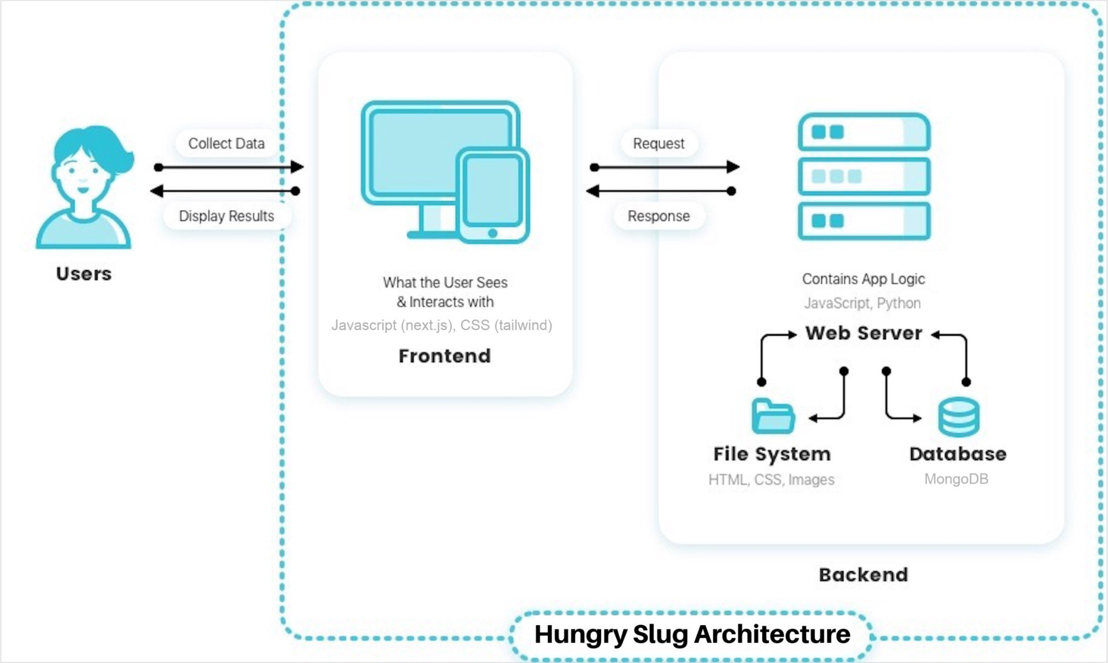
Architecture

Slide 9



Technologies
Programming Languages: Python, Javascript
Web Frameworks: Django, Next.js, CSS, MongoDB
Development Tools (Organization): Github, VSCode, Nix Shells

Slide 10
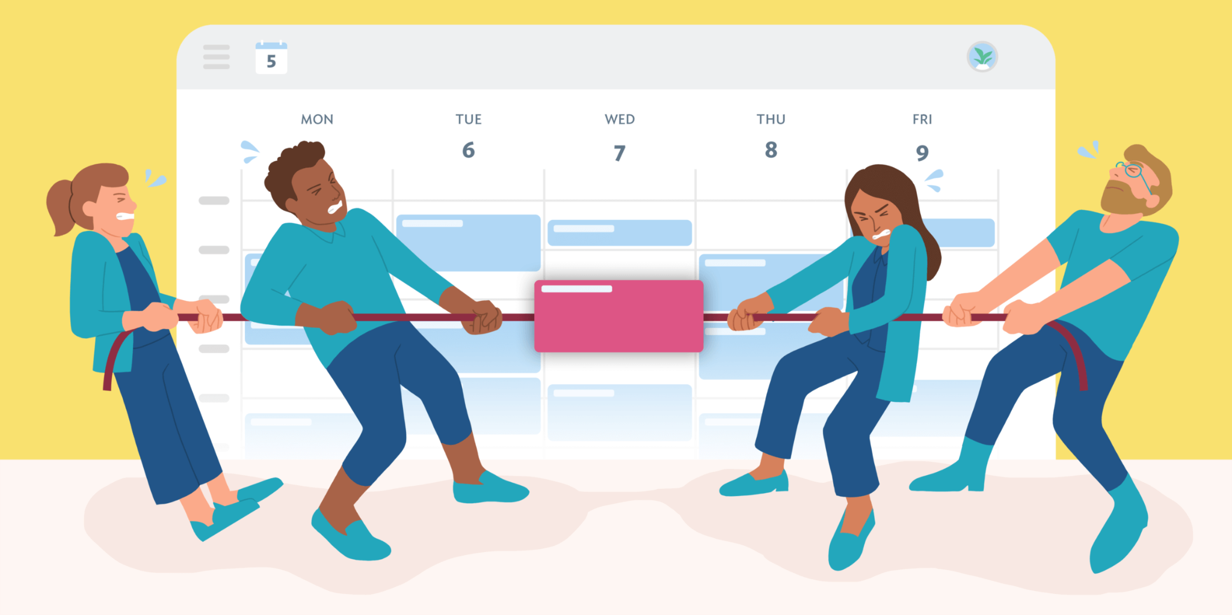
Challenges/Risks
Unfamiliar Technology
Working in a Larger Team - Scheduling Conflict
Database functionality with Python backend
Sequential Tasks require previous tasks to be finished - large downtime

Slide 11
Minimum Viable Product (MVP)
As a user, I want to know what food is available at the dining hall, so that I can decide if I like what dining hall has to offer.
As a student with allergies, I want to easily know how much food at a dining hall fits my dietary restrictions, so that I know what foods are available for me.
As a user, I want to know when a dining hall has my favorite foods, so I can factor that into my decision that if I should go.
As a user, I want to be able to share pictures of food I get at the dining hall and share it, so that I can show the quality of the food being served.
As a user, I want to be able to interact with others about food I get at the dining hall, so that I can communicate with other users about the dining hall.
As a user, I want to be able to save my information, so I can keep track of posts and what my food preferences are.

